Slide 1
Sub-Selects in Other Places

Slide 2
Subselect in Other Places
A select statement may be used in a “from” or a “select” part of a query
Select A.F1, A.F2, B.F3 …
From A join B on A.F1 = B.F3
Where A.F1 > …

Slide 3
Student Application Database
ITP(itpName, region, enrolment)
Student(sID, sName, GPA, sizeHS);
sizeHS is size of High School
Apply(sID, itpName, major, decision);

Slide 4
SubSelect in Select
It is possible to use a subselect in a select clause. Why?
I have NO idea! But you can if you must.
But the subquery must return a scalar value
Ie a single value in a single row
E.g.
select sname, gpa, (select max(gpa) from student) as maxgpa from student;
Must give new table a name

Slide 5
Subselect in select
Sometimes though we might want to return some values
E.G. How many films exist in Sakila, how many do we have and how many are we missing

Slide 6
Building it up
select count(*) as total_films from film;
Select count(*) as in_stock from inventory;
Then we just need to total_films – inventory … somehow
Try those two statements first – any problems ?

Slide 7
Building it up
select count(*) as total_films from film; → 1000
Select count(*) as in_stock from inventory; → 4581
Hey – hang on – we’ve more films in stock than actually exist – how is that possible?
it isn’t! We made a mistake.

Slide 8
Check the data
Lets take a look at the data
Select * from inventory limit 100;
The “limit n” keyword takes the first n records only

Slide 9
Building it up – new plan
select count(*) as total_films from film; → 1000
Select count(distinct film_id) as in_stock from inventory;
Then we just need to total_films – inventory … somehow
Try those two statements first – any problems with out thoughts?

Slide 10
Putting it all together
select (select count(*) from film) as film_count , (select count(distinct film_id) from inventory) as inventory_count, (select film_count - inventory_count) as missing;
Notice there is no “from” clause in our main statement.

Slide 11
Outer Joins
Inner, Outer, Left Right

Slide 12
Joins so far: Cartesian
Cartesian join (aka “cross join”)
combines every row in one table with every row in another
SELECT * FROM film, inventory;
Almost always an error!
Unless you then go on to restrict
Did not tell SQL how to do the join.

Slide 13
Joins So Far: Inner Join
Also known as equi-join
Most common.
Tells MySQL to join the tables when specified fields are equal
SELECT * FROM film f JOIN inventory i ON f.film_id = i.film_id;

Slide 14
Looking at tables as sets
Think of each table as a set of records
Where key fields are the same we have an overlap
Table-A
Table-B

Slide 15
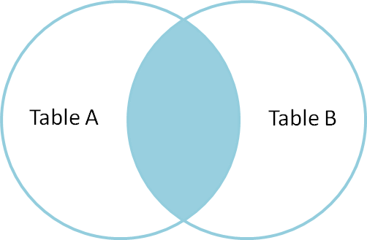
Inner Join – The Intersection
Joining two tables based on the equality of a field gives you the intersection.
The field for the join really needs to be the foreign key
Does it need to be?
No – you can do dumb things.
Graphic from http://www.codinghorror.com/blog/2007/10/a-visual-explanation-of-sql-joins.html

Slide 16
A dumb thing – not using FK to join
SELECT staff.first_name, staff.last_name, film.title FROM staff join film ON staff.staff_id = film.film_id;
+------------+-----------+------------------+
| first_name | last_name | title |
+------------+-----------+------------------+
| Mike | Hillyer | ACADEMY DINOSAUR |
| Jon | Stephens | ACE GOLDFINGER |
+------------+-----------+------------------+
2 rows in set (0.08 sec)

Slide 17
Inner Join – The Intersection
id name id name
1 Pirate 1 Rutabaga
2 Monkey 2 Pirate
3 Ninja 3 Darth Vader
4 Spaghetti 4 Ninja

Slide 18
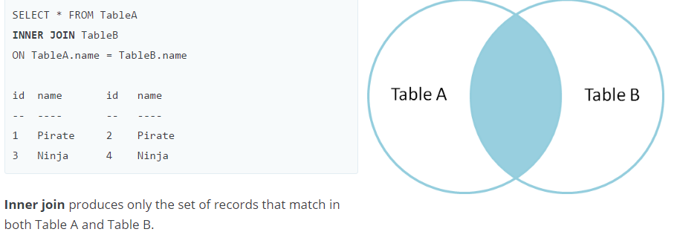
Inner Join – The Intersection

Slide 19
Outer Joins
How would we get all the records from one table,
Even if there isn’t anything matching on the other one?
What? Why would we?
How about ...
Make a list of films with their inventory-id’s – even if we don’t have any in stock

Slide 20
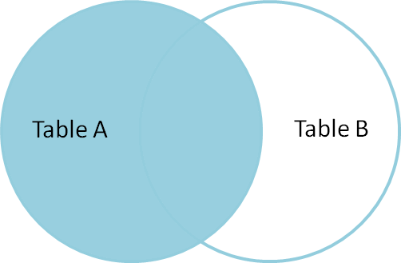
Left Outer Join
Left outer join produces a complete set of records from Table A,
with the matching records (where available) in Table B.
If there is no match, the right side will contain nulls.
Graphic from http://www.codinghorror.com/blog/2007/10/a-visual-explanation-of-sql-joins.html

Slide 21
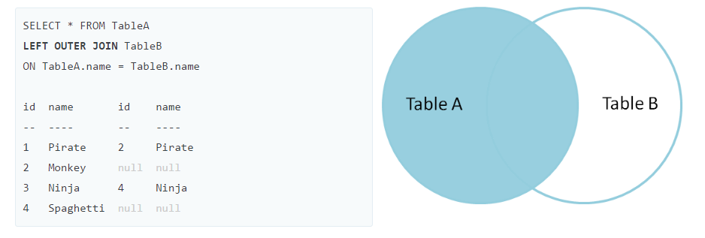
Left Join

Slide 22
Right Join
A right join displays all of the records on the right-hand table.
You can achieve the same thing by using a LEFT JOIN and reversing the tables listed
SQLite does not support right join

Slide 23
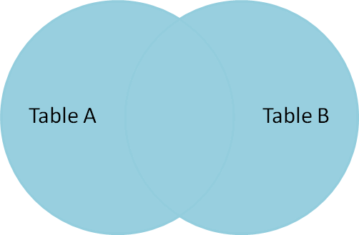
Full Outer Join
Full outer join produces the set of all records in Table A and Table B, with matching records from both sides where available.
If there is no match, the missing side will contain null.
MySQL and SQLite do not do this – But T-SQL does

Slide 24
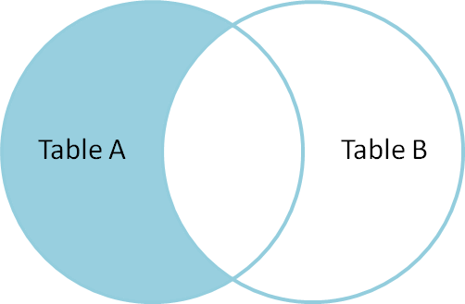
Left Right Out Join
Ok – that’s not a real name of a join.
How do we select the records from one table which have no match in the second table?

Slide 25
Which films don’t we have
Are there any films in our list which do not appear in our inventory?
Perform a left join
Filter for nulls in the fields from the right hand table

Slide 26
Working with NULLS
You can’t test for nulls with “=“
NULL is an absence of a value – you can’t check if a value equals a “non”-value.
Test with:
IS NULL
IS NOT NULL

Slide 27
Which films are we missing?
SELECT F.title FROM film F LEFT JOIN inventory I ON F.film_id=I.film_id WHERE I.film_id IS NULL;
ALICE FANTASIA |
| APOLLO TEEN |
| ARGONAUTS TOWN |
| ARK RIDGEMONT |

